Slide 1


Slide 2
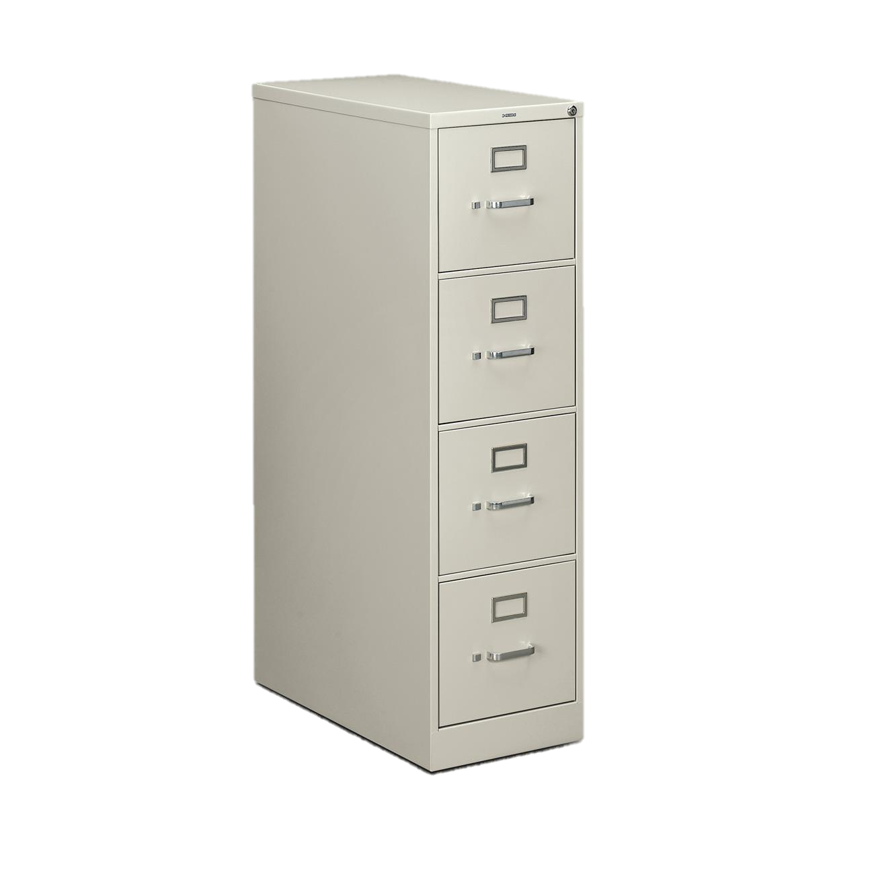



Spring Cleaning
Notes:
New from Clearwater Computing
It’s now Spring
And that means it is time for Spring Cleaning
What does Spring cleaning mean for you?
<click>
It probably does not mean with a mop and bucket
<click>
It is time for spring cleaning your filing cabinet

Slide 3
Announcing
Clearwater Filer
Notes:
Rahimi

Slide 4
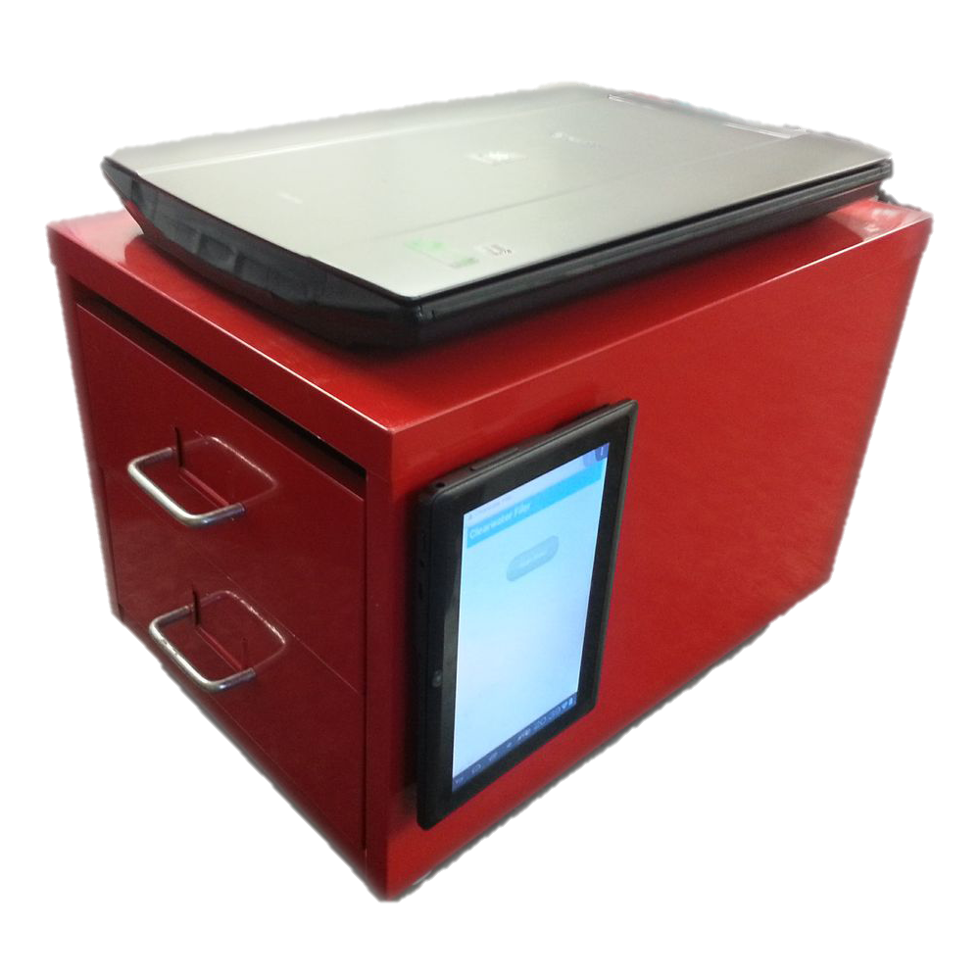
Notes:
Rahimi

Slide 5
Scan and say goodbye
1
Because it should be that easy

Slide 6


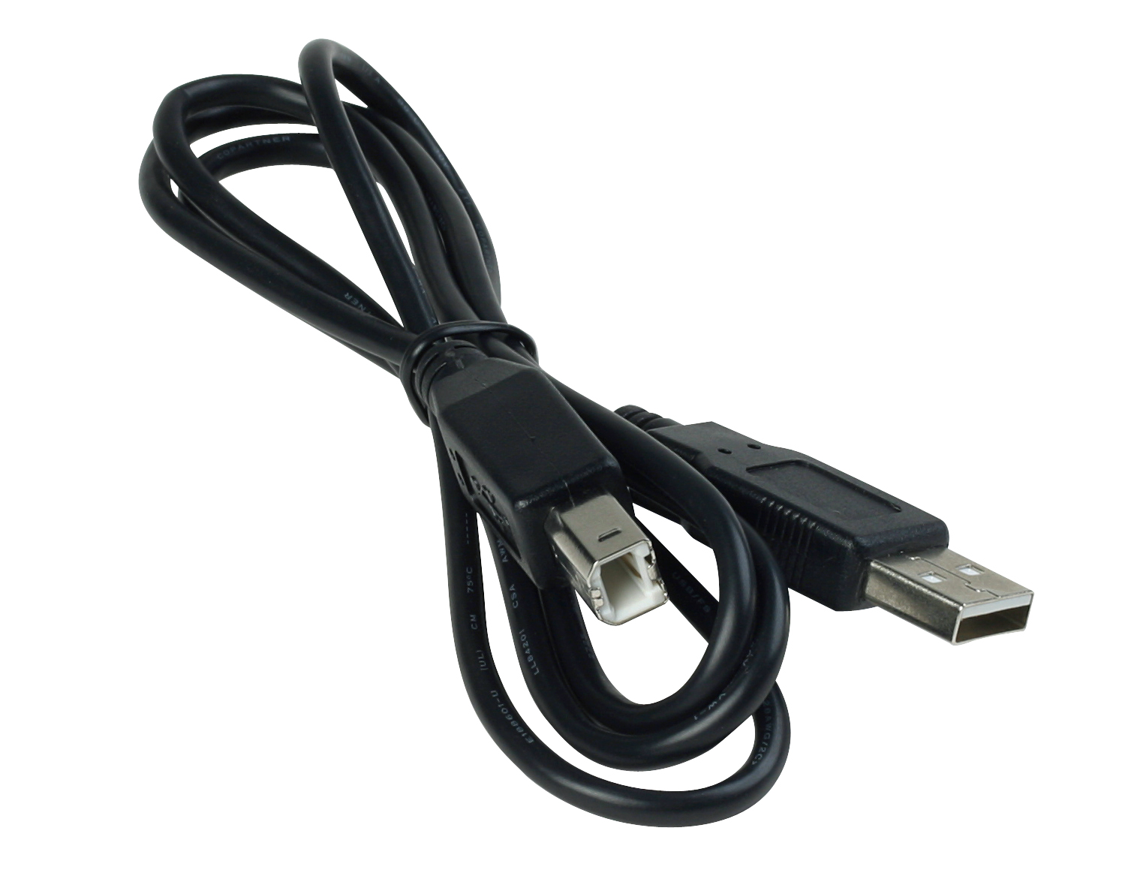
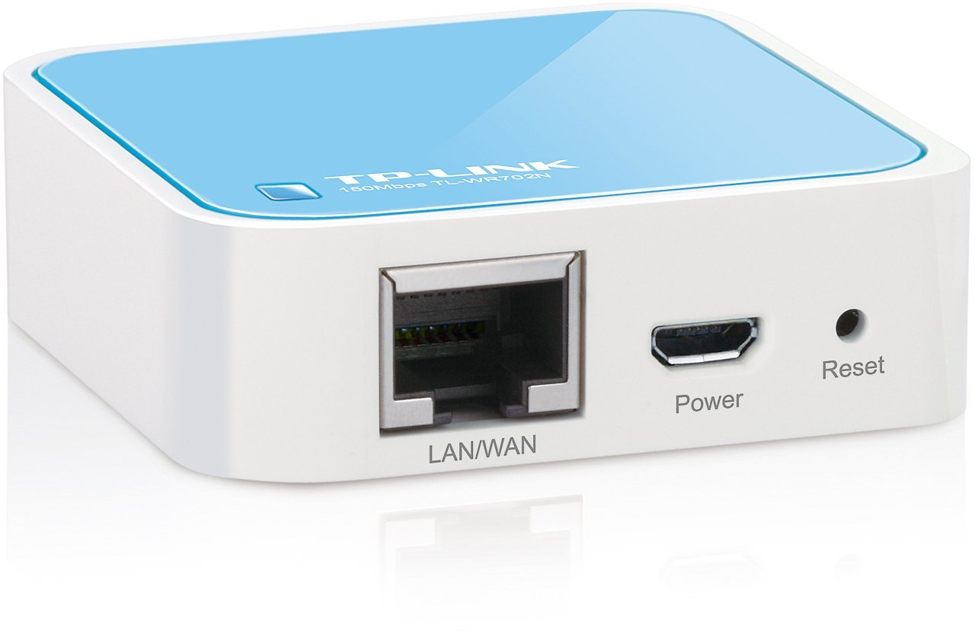
No USB and hassle-free
Paper is wireless. So are its modern equivalents.
You should be able to scan without booting up a computer, installing drivers, or setting parameters
The Clearwater Wireless Adapter provides zero configuration secure wireless connectivity to the Filer. Just connect the Adapter to a nearby Ethernet port and enjoy wireless scanning with no setup at all.
Notes:
Rahimi

Slide 7

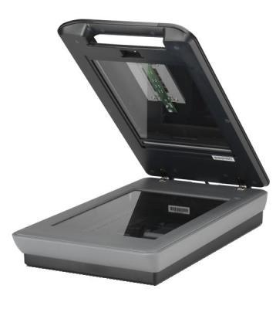
Web Based Scanning for the first time
Use a mobile friendly UI to activate the scanner from any device with no complex connectivity or software
Use an innovative on-scanner interface to quickly and painlessly scan multi-page documents
Notes:
Rahimi

Slide 8
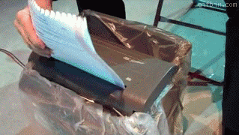
Shred in confidence
Notes:
Harry
We are so confident that you will always be able to access your documents that we encourage you to shred your excess paper. Your documents are safe with us!

Slide 9

Enjoy Easy and Automatic Filing
2
Tag when you scan, or let the computer do the work. Always find your files either way
Notes:
Harry

Slide 10
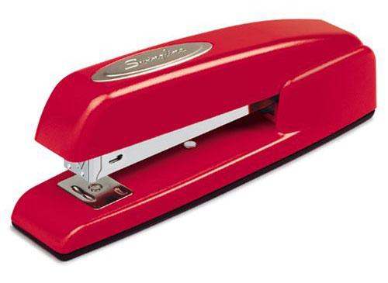
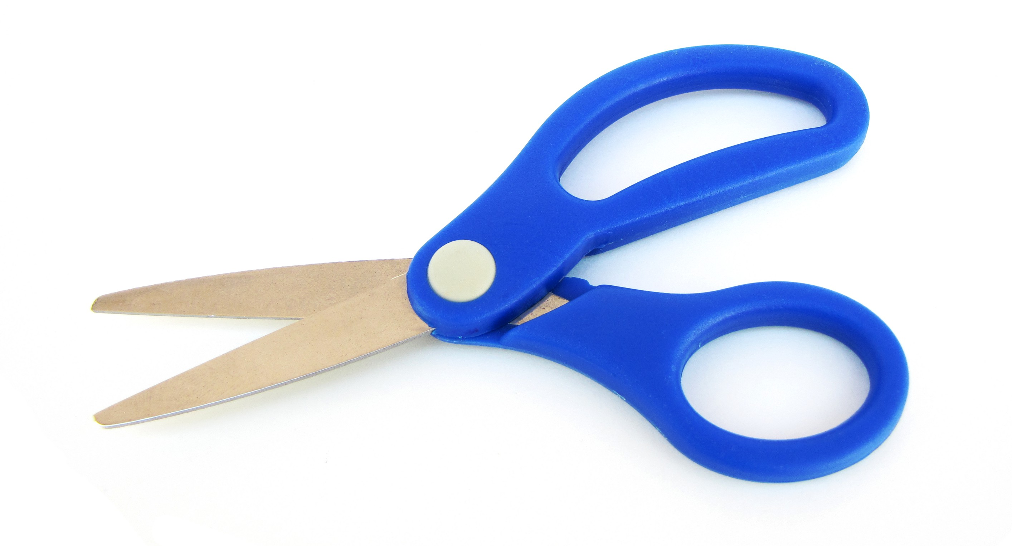
Staples and Scissors
Sort documents however you choose. Use Staples to create easy-to-navigate multipage documents
Use scissors to crop individual scans while scanning, even in multipage documents.
Notes:
Harry

Slide 11


Plug in to more functionality
A robust plugin framework supports infinite expansion for new ways of classifying your documents and uploading to cloud services
Clearwater Filer’s Optical Character Recognition plugin utilizes Tesseract to enable easy searching with minimal effort
Notes:
Harry

Slide 12
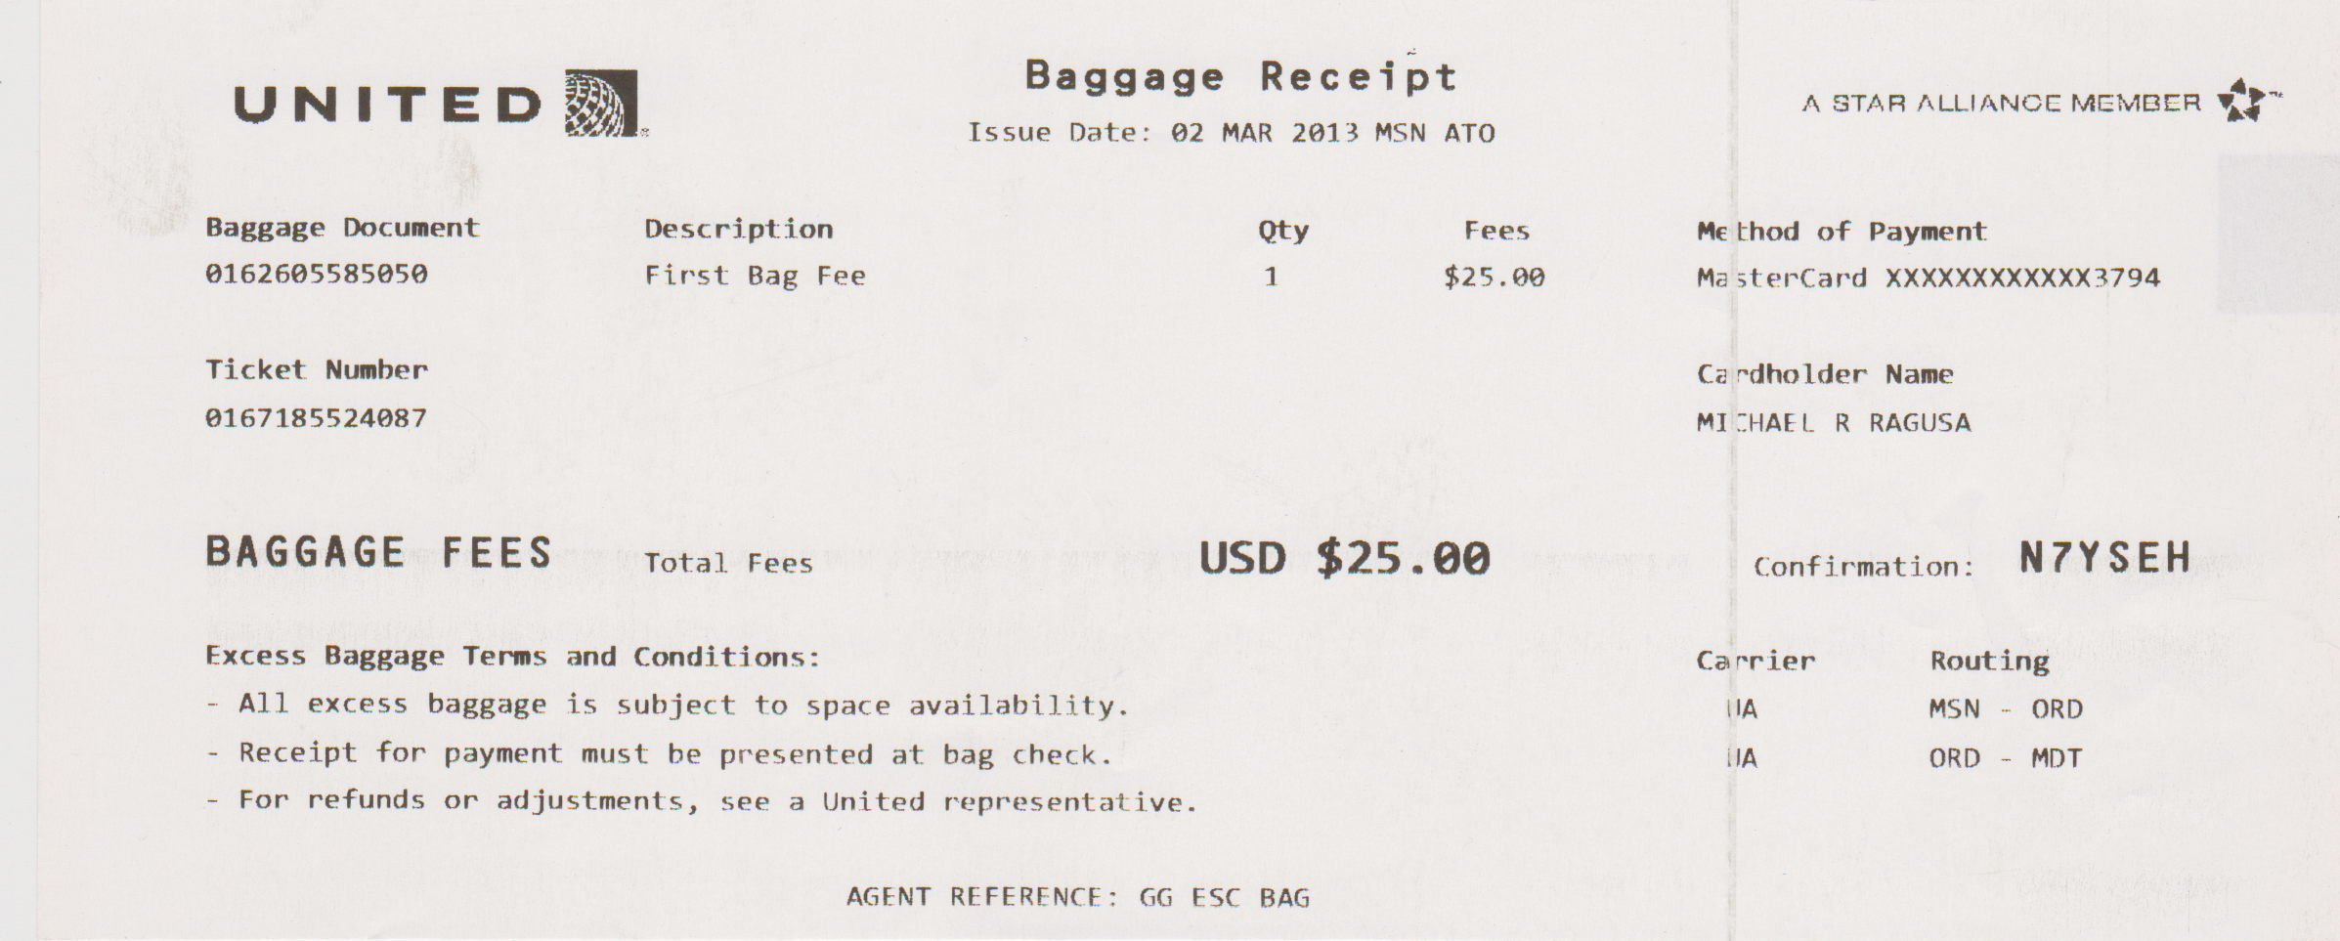
OCR is awesome
uNITED@, Baggage Document 0162605585050 Description First Bag Fee Ticket Number 0167185524087 BAGGAGE FEES Total Fees Excess Baggage Terms and Conditions: — All excess baggage is subject to space availability. — Receipt for payment must be presented at bag check. Baggage Receibt Issue Date: 02 MAR 2013 MSN ATO Qty Fees 1 $25.00 uso $25.99 - For refunds or adjustments, see a United nepresentative. AGENT REFERENCE: GG ESC BAG
A sum ALLIANCE MEMBER '3" Method of Payment MasterCard XXXXXXXXXXXX3794 Cavdholder Name MIZHAEL R RAGUSA Cmﬁmmmm N7YsEH Carrier Routing HA MSN — 0RD HA ORD — MDT
Notes:
Harry

Slide 13
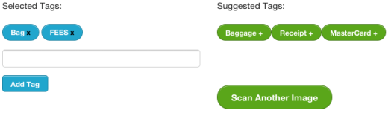
Tag it… or don’t
Notes:
Harry

Slide 14
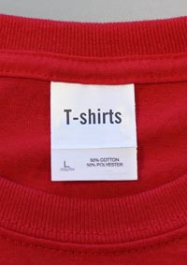
Tag it… or don’t
Tag your documents however you choose. Add, remove, or change tags at any time.
Or if you’re feeling lazy, just use the tags that the Filer suggests for your document.
Notes:
Harry

Slide 15
Access and redistribute effortlessly
3
Because that’s what the digital age is all about
Notes:
Mike

Slide 16
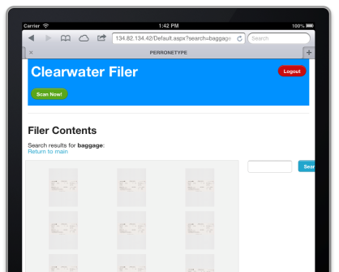
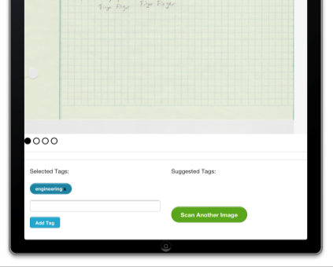
Tablets are today’s paper
Search, View, and Explore from any tablet with an intuitive touch friendly web interface.
Tablet based scanning interface makes it easy to see your documents and save tags
Notes:
Mike

Slide 17



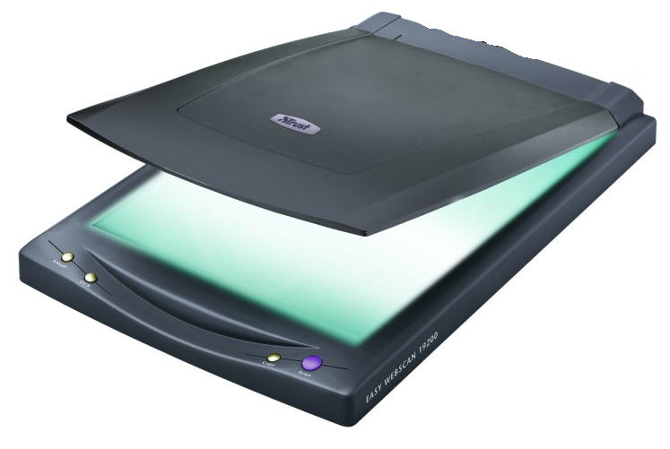
Collaboration
Notes:
Mike

Slide 18
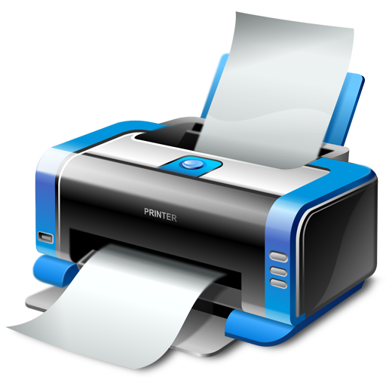
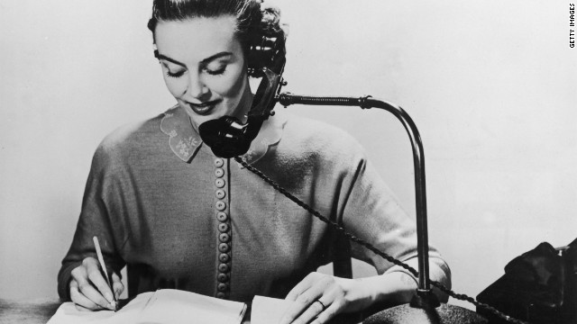
Recreate whenever you need to
Go back to paper every time you need to. Trigger printing straight from the web interface
Easy for old-fashioned people to still see documents without making you less organized
Notes:
Mike

Slide 19
Digitizing Your Life
1
2
3
Scan and Shred All Your Paper
Enjoy Easy and Automatic Filing
Access and redistribute effortlessly
We have features for every step of the way
Notes:
Rahimi

Slide 20

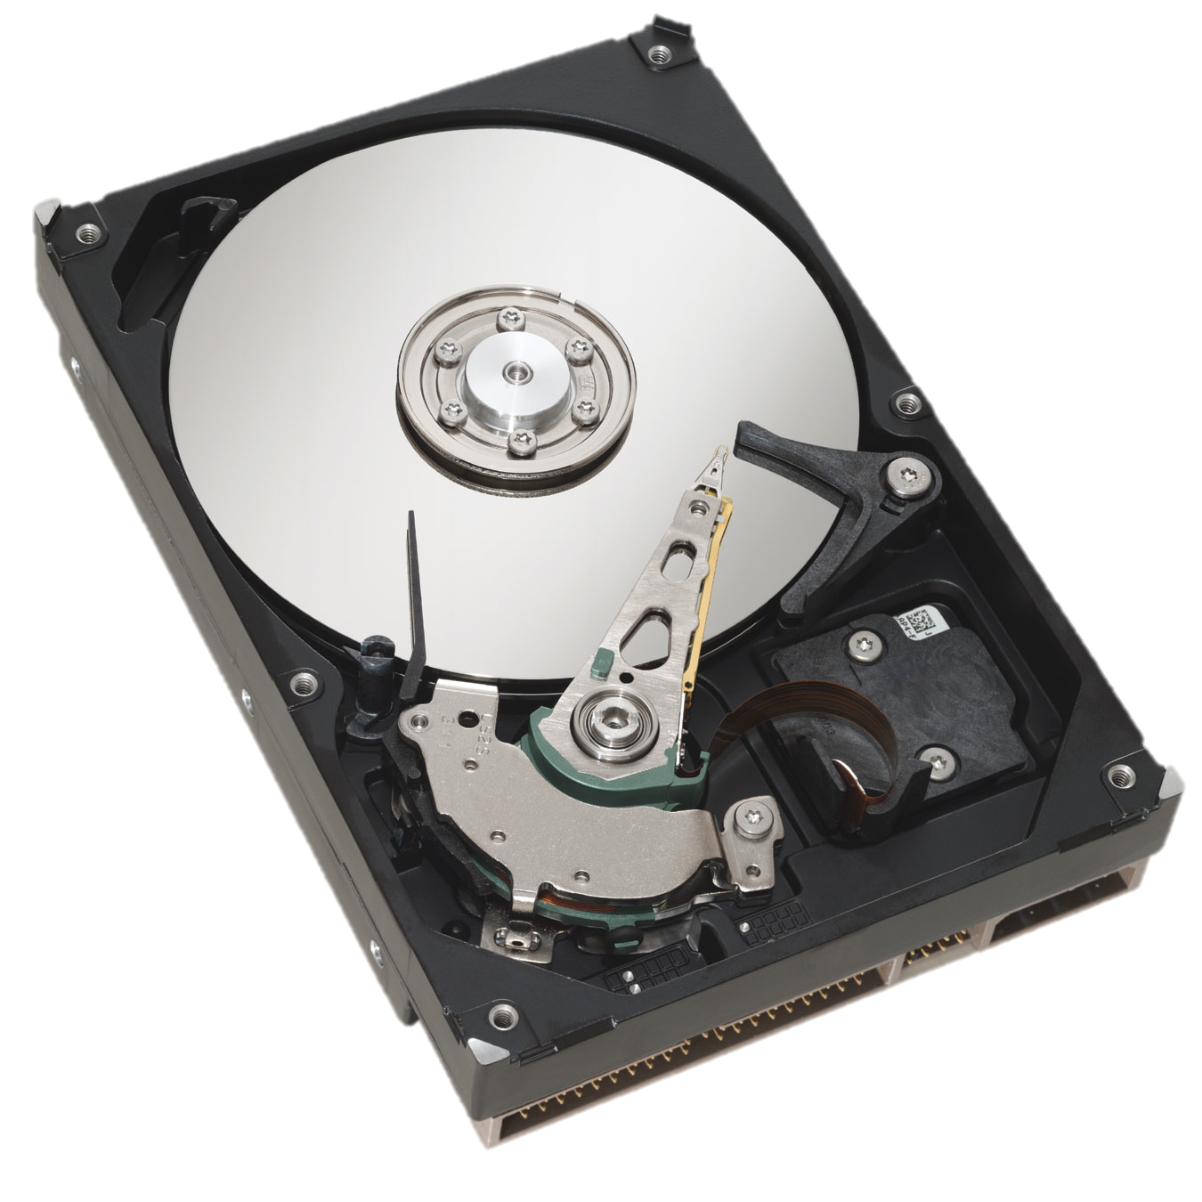
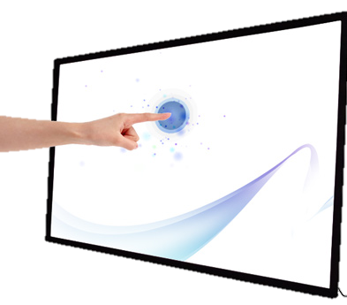
Combining Technologies
Notes:
Rahimi

Slide 21

Combined Technologies
ASP.NET
Microsoft WIA
C#
MySQL
Windows 8
SCSS
Tesseract
jCrop
Notes:
Mike

Slide 22
Combined Technologies
Scanner
Plugin Layer
FS Access
Tablet Interface
Web Interface
Provider
Processor
(Back End)
IIS Web Server
(Front End)
HTTP
Connector
MySQL Database
Notes:
Mike

Slide 23
Front End Technologies
View.aspx
default.aspx
Login.aspx
Tablet.aspx
Provider.cs
IIS Web Server
(Front End)
Handler.ashx
Connector
MySQL Database
Filesystem
Notes:
Mike

Slide 24
Back End Technologies
Management Plugins
WIA
Capture Plugins
Scanner
Image Manipulation
Processor
Connector
MySQL Database
Filesystem
Notes:
Mike

Slide 25
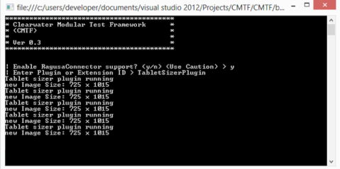
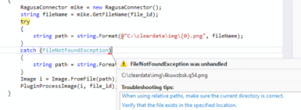
Well Tested
We wanted a way to test the Clearwater Filer, but there were so many components and hardware dependencies.
Our test framework needed to be modular. We wanted to capitalize on the unique extensible nature of our product
So we created the Clearwater Modular Test Framework!
(CMTF)
And we actually found a bug with it!
Notes:
Rahimi

Slide 26
Well Tested
Plugin Layer
processImage(Image i, int file_id)
Plugin Layer Test Backend
Plugin Test Controller
Image Data
Virtual Capture API
Mock Database Server
Notes:
Rahimi

Slide 27
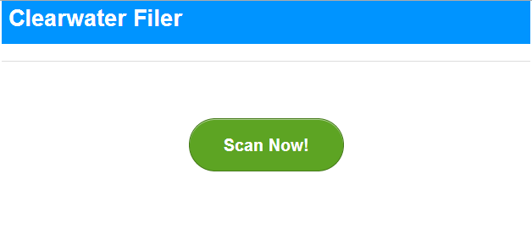
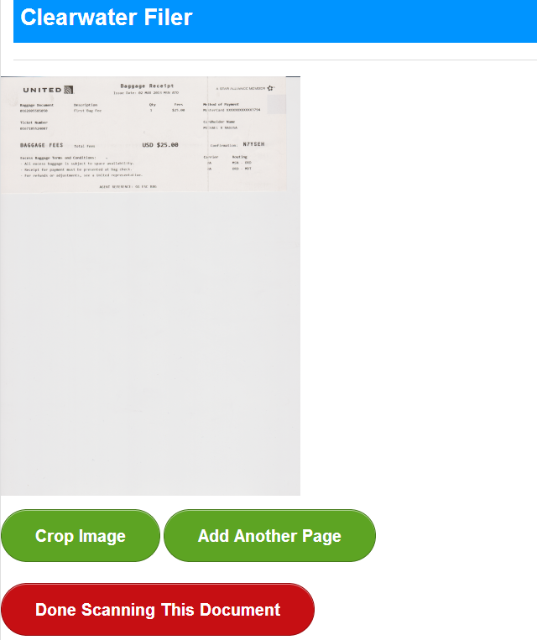
Demo - Scanning

Slide 28
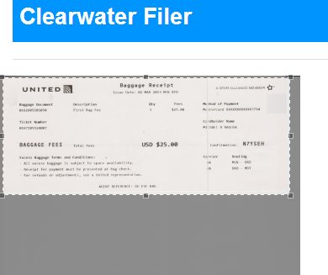
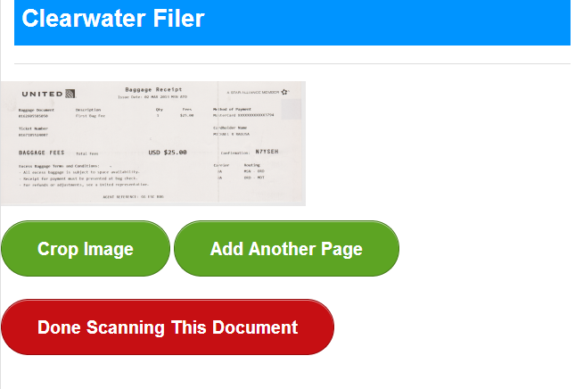
Demo - Scanning

Slide 29
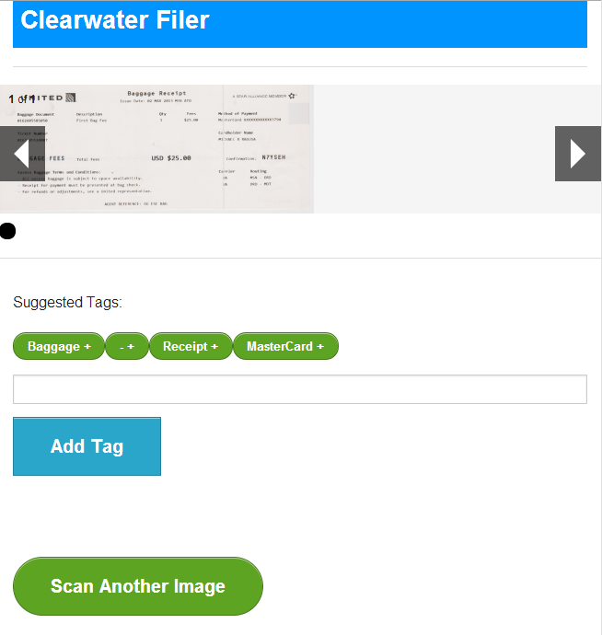
Demo - Scanning

Slide 30
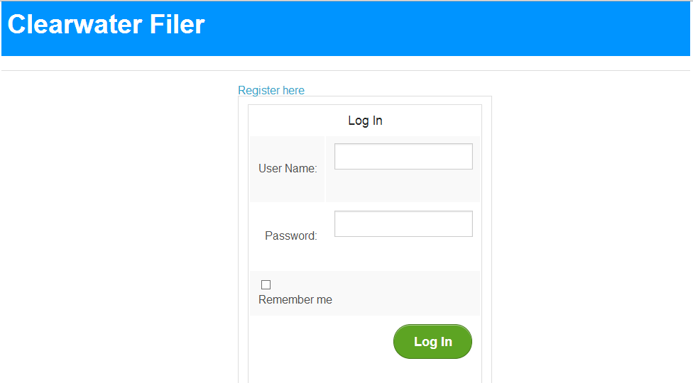
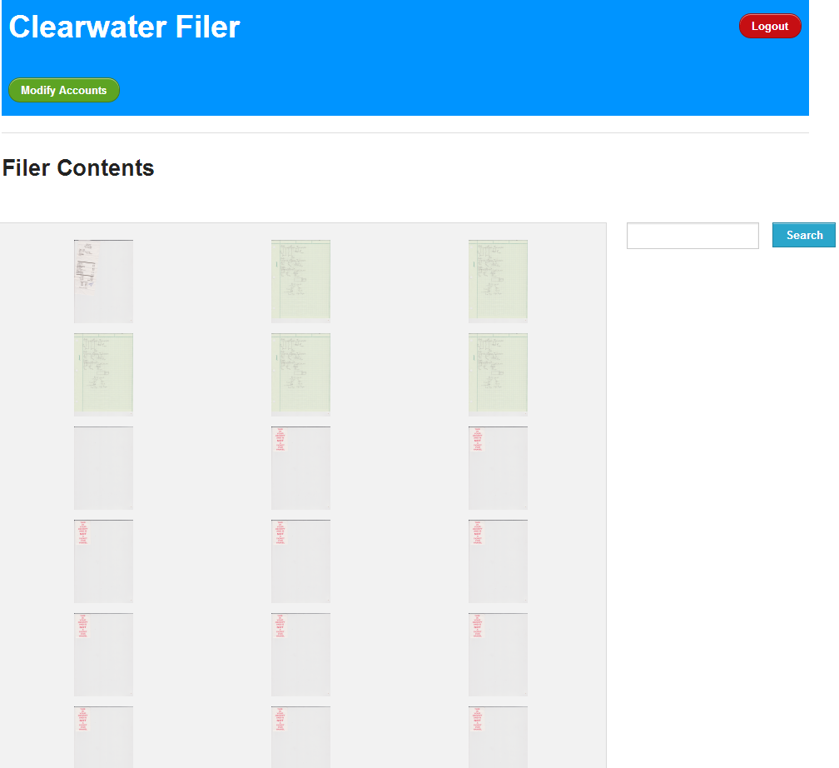
Demo - Viewer

Slide 31
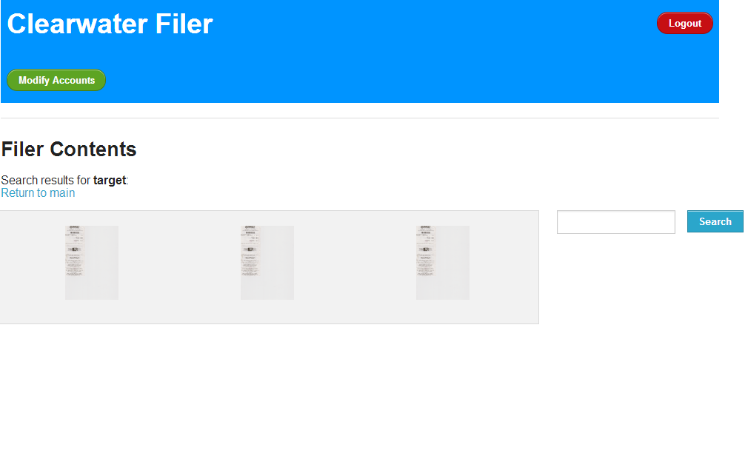
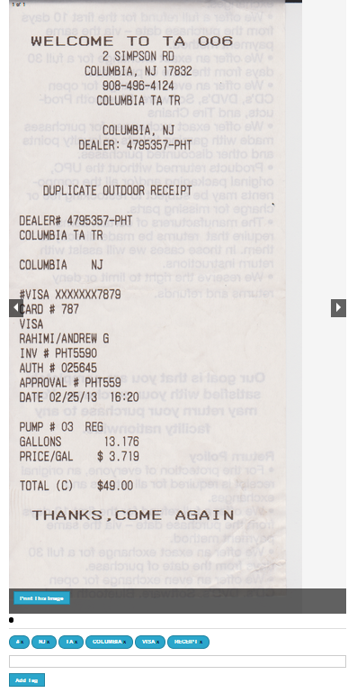
Demo - Viewer

Slide 32
Challenges Met and Lessons Learned
Processor
Automatic Cropping
Networking
Notes:
Mike

Slide 33
Future Work
Cloud Service Integration
Mobile Device Camera Uploading
More Elegant/Faster Tablet UI
SFTP or network drive access
Expansion of Clearwater Wireless Adapter functionality
Paperclip
Notes:
Mike

